Slide 1
On Time or Not?
Predicting Delivery Delays in Brazil’s Olist Marketplace
Chentong Hao
October 24, 2025
Data Science Institute
https://github.com/chentonghao/Midterm
Notes:
Hi everyone, I’m Chentong Hao from Data Science Institute,.
My project is about predicting delivery delays in Brazil’s largest e-commerce platform, Olist.

Slide 2


1 Problem Introduction
🤯
Have you ever ordered something online, checked the tracking page five times a day,and still wondered — “Why hasn’t my package arrived yet ???”
Problem Definition:
Predict whether an e-commerce order will be delivered on time.
Why It Matters:
Delivery punctuality → key to customer satisfaction
Late orders → harm seller reputation
Accurate delay prediction → optimize logistics operations
Type of Task: Binary Classification
Target: is_late
1 → Delivered after estimated date
0 → Delivered on time
Notes:
The reason why I chose this dateset is that I’m really interested in e-commerce, and one key factor in customer experience is whether the order arrives on time.
Late deliveries can negatively impact both customer satisfaction and the reputation of sellers on the platform.
So in my project, I aim to predict whether an order will be delivered on time or delayed.
This is a binary classification problem, and my target variable is is_late.
I created is_late by comparing the actual delivery date with the estimated delivery date.

Slide 3


2 Dataset
Source: Olist — Brazil’s largest e-commerce platform
Public release on Kaggle (Olist data-sharing initiative)
Real transactional records from 2016–2018
Each row = one real order
Three challenges:
Large: over 100k orders and multiple linked tables.
Non-iid : multiple orders come from the same customers
Some tables contain missing values(<0.1%) .
Notes:
The dataset comes from Olist, which is Brazil’s largest e-commerce platform.
It was publicly released on Kaggle as part of Olist’s data-sharing initiative.
The data contains real transactional records from 2016 to 2018,
and each row represents one actual order placed on the platform.
The main challenges are, first, the dataset is large and comes from multiple linked tables — such as orders, customers, sellers
Since these were provided as separate CSV files, I used what I learned from DATA1050 to carefully merge and preprocess them before analysis.
Second, the dataset itself is not fully IID, because the same customer or seller may appear in multiple orders.
But for later splitting and modeling, I treat each order as an independent sample.
And finally, there are some missing values, less than 0.1% in 4 columns.

Slide 4
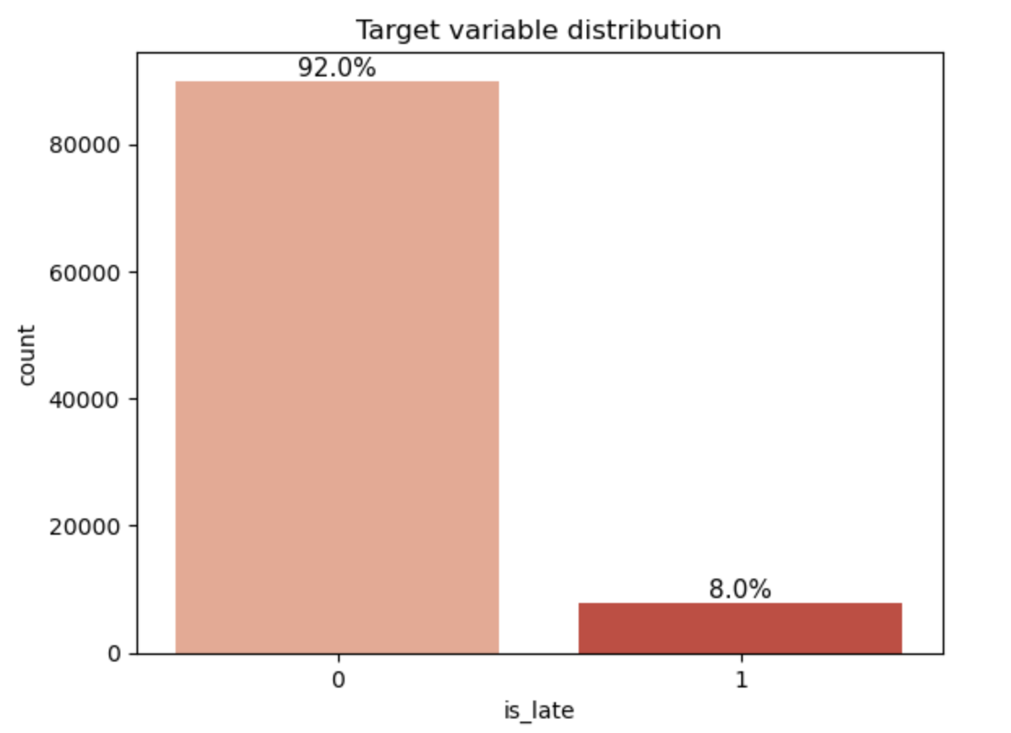
3 EDA
A strong class imbalance
Notes:
The first figure shows the distribution of my target variable, is_late.
As you can see, the data is quite imbalanced — most orders were delivered on time,
which means Olist’s logistics system generally performs well.
But this imbalance also means the model could easily learn to always predict “on time.”
To address this, I plan to use techniques like class weighting.
And when evaluating performance, I’ll focus on the F1 score instead of accuracy,

Slide 5

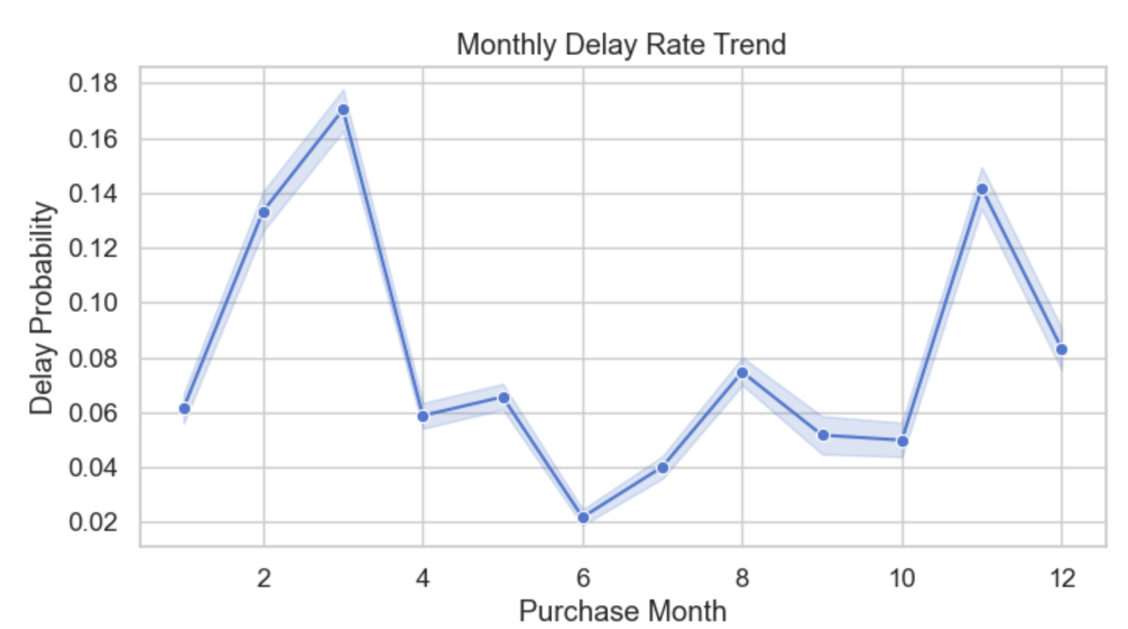

3 EDA
Delay peaks in February - March
Lowest delay around June
Second spike in November
Holiday Possible cause?
Notes:
This is one of the most interesting findings from my EDA —
Here, the x-axis shows the purchase month, which I extracted from the order timestamp,
and the y-axis shows the delay rate.
We can see that the delay rate changes a lot across months.
The first big peak appears between February to March. Although I don’t know much about Brazil, I searched on Internet and it turns out that it’s Brazil’s Carnival season —
a time when order volume likely increases, and many delivery workers may be on holiday.
This made me wonder — should the platform adjust its delivery estimates around national holidays,
since deliveries during those periods are naturally expected to take longer?
Then, the second spike appears in November,
which matches the Black Friday sales period.

Slide 6
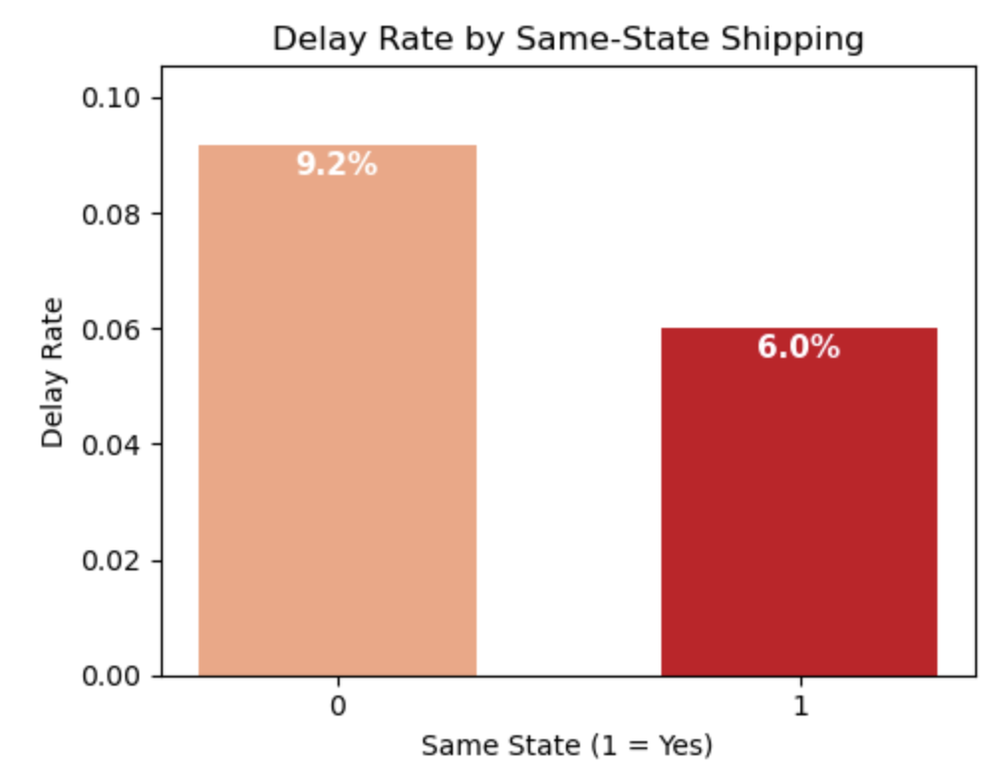
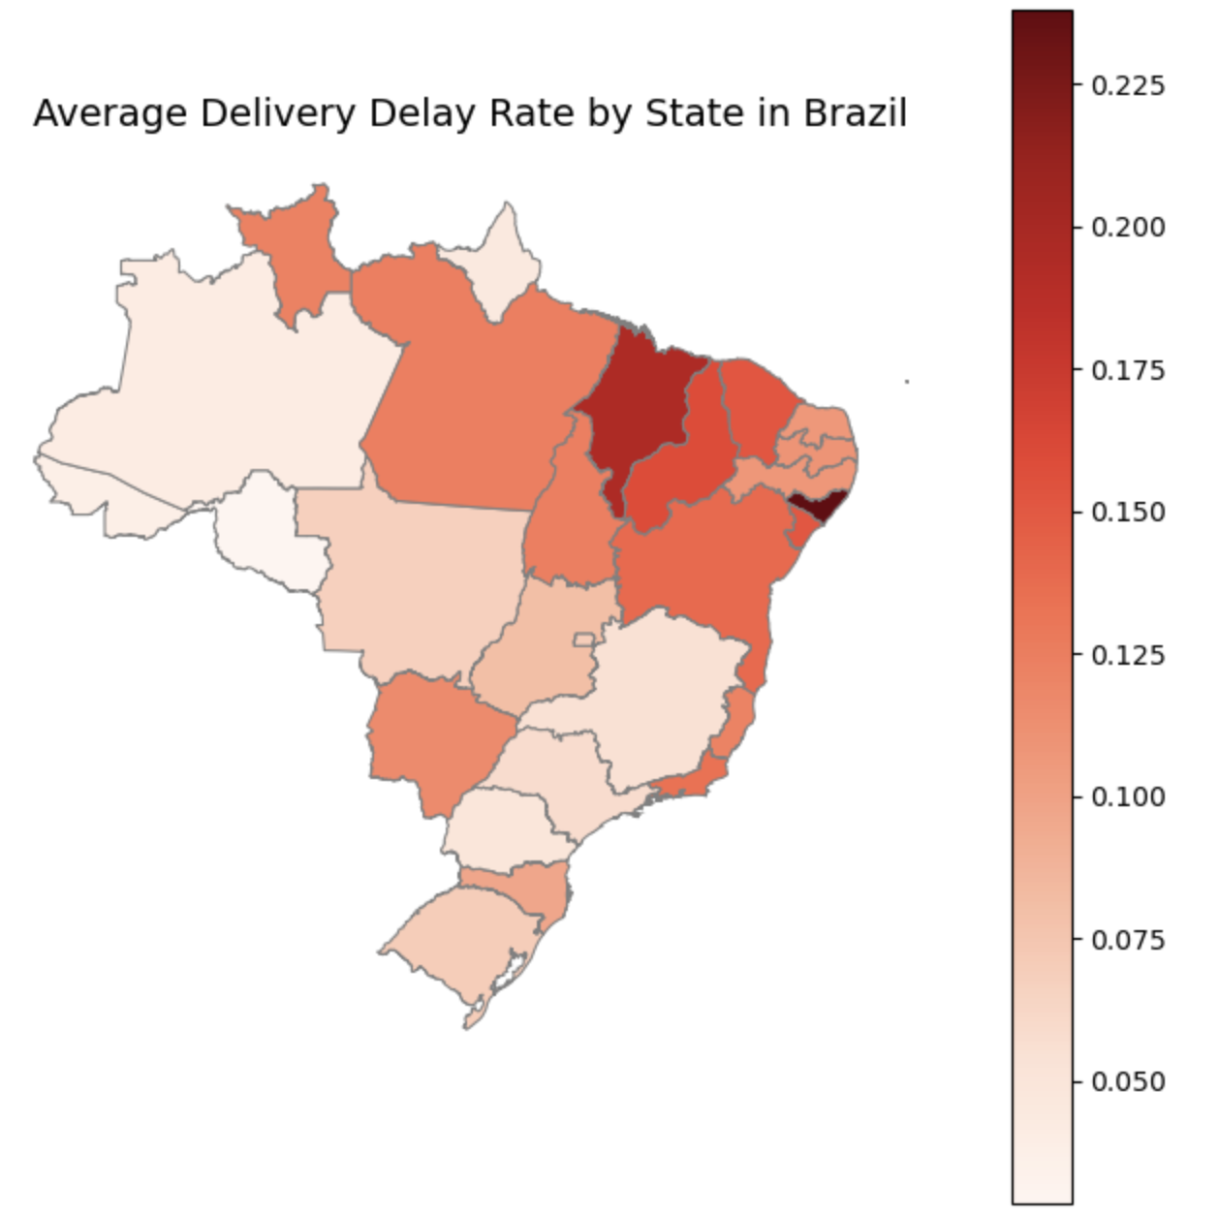
3 EDA
Cross-state orders → higher delay rate
Same-state orders → fewer delays
Shipping distance likely main factor
Notes:
I also wanted to explore whether geography plays a role in delivery delays.
On the left, we can see that same-state orders have a much lower delay rate,
while cross-state orders are delayed more often — which makes sense.
I also mapped the average delay rate by state across Brazil, shown on the right.
We can see that the northeastern region has noticeably higher delay rates.
This area is generally less developed in terms of logistics and infrastructure,
which could explain the slower deliveries.
So overall, location seems to be an important factor behind delivery performance.

Slide 7
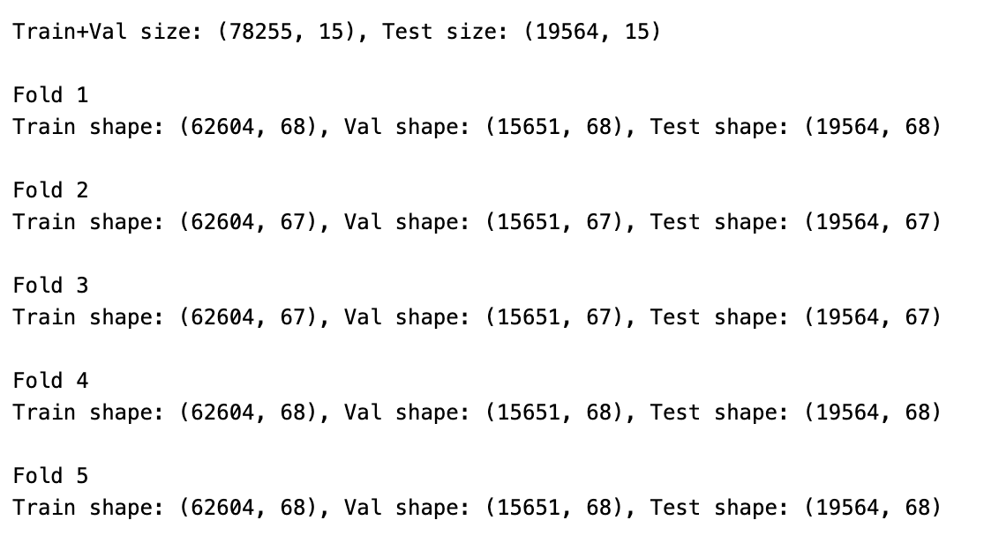
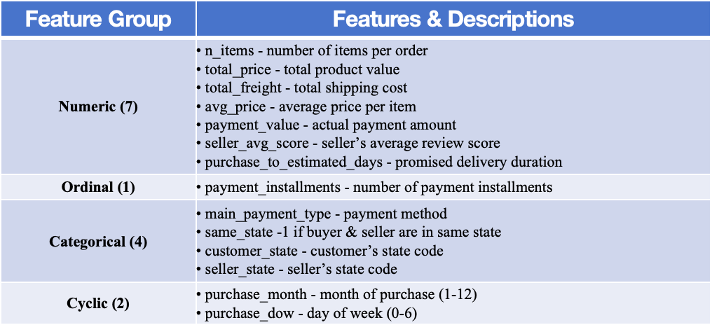
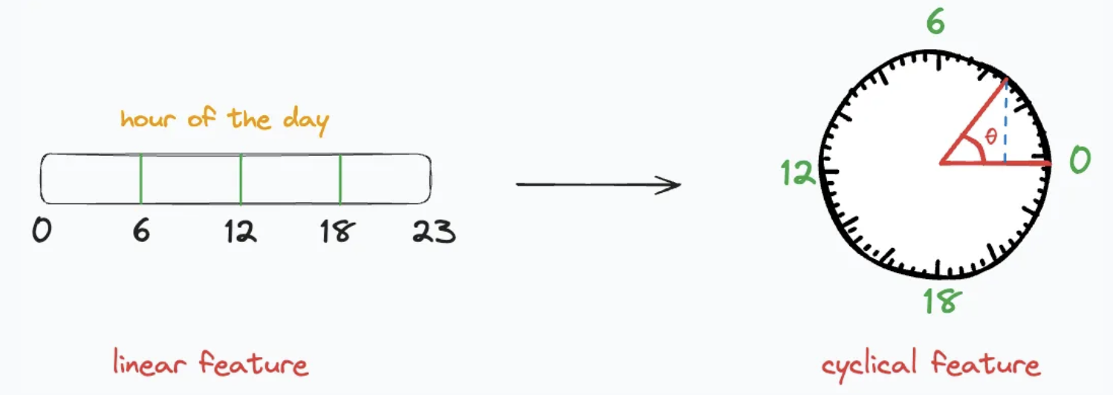
4 Splitting and Preprocessing
Splitting:
Used standard train_test_split to divide the dataset into 80% training + validation and 20% test
Within the 80% training+validation portion, applied 5-fold KFold cross-validation
Preprocessing:
StandardScaler → numerical & linear ordinal features
OneHotEncoder → categorical features (payment_type, state)
Cyclic encoding → temporal features (month, day_of_week)
Picture from blog cyclical-feature-engineering
Notes:
After finishing the EDA, I split the dataset into training, validation, and test sets.
Since orders are independent from each other, I used a standard train_test_split, keeping 80% for training and validation, and 20% for testing.
Within the 80%, I applied 5-fold K-Fold cross-validation to make the evaluation more reliable and reduce randomness.
For preprocessing, I standardized numerical and ordinal features using StandardScaler,
one-hot encoded categorical,
and applied cyclic encoding to temporal features like month and day of week.
I chose cyclic encoding because these time features are naturally circular — for example,
December and January are close in time, even though their numeric values (12 and 1) look far apart.
If I standardize or treat them as linear numbers, the model would incorrectly assume a large gap between them.
Cyclic encoding solves this by projecting each time point onto a unit circle,
using sine and cosine transformations to capture their periodic relationship —
visually, each point’s position on the circle represents its place within the cycle.
3.

Slide 8
Q&A
Notes:
1.Iid
Strictly speaking, the Olist dataset is not fully IID.
There are correlations because the same customer or seller may appear multiple times, and some temporal or regional dependencies exist.
However, in my project, I am building the model at the order level — each row represents an order.
At this granularity, it is reasonable to approximate orders as independent samples, since each order is a separate transaction with its own timestamp and conditions.
If I were doing a customer-level prediction (for example, predicting whether a customer will experience a delay in their next order), then I would definitely need to use group-aware splitting by customer ID to avoid information leakage.
But since I am predicting at the order level, group splitting is less critical, as the model focuses on the characteristics of each transaction rather than a specific user’s long-term behavior.
2.
Class weighting is a technique to handle imbalanced datasets by assigning higher weights to the minority class during training.
This makes the model pay more attention to rare cases — for example, delayed orders — without changing the dataset itself.
In practice, models like logistic regression or tree-based methods can automatically adjust these weights using the option class_weight='balanced’.
3. For each seller, we calculated a historical average review score using only the reviews that were created before the current order.
This ensures the feature is time-consistent — the model only has access to information that would have been available at the time of the order.
If a seller had no past reviews, we filled the value with the global average rating across all sellers.
4. Cyclic encoding (or cyclical feature encoding) is used when a feature represents a repeating cycle, such as month, day of week, or hour of day.
Since these variables are periodic — for example, day 0 (Sunday) and day 6 (Saturday) are next to each other — treating them as plain integers (0–6) would make the model think that 0 and 6 are far apart, which is wrong.
To fix this, we use sine and cosine transformation to map them onto a circle:
\text{sin\_col} = \sin\left(\frac{2\pi \cdot \text{value}}{\text{period}}\right), \quad \text{cos\_col} = \cos\left(\frac{2\pi \cdot \text{value}}{\text{period}}\right)
For example:
For day of week (0–6), the period is 7
For month (1–12), the period is 12
This way, the model learns that day 0 and day 6 are close, not opposite.

